Slide 1
2024 Senior Application Process
Welcome All!

Slide 2
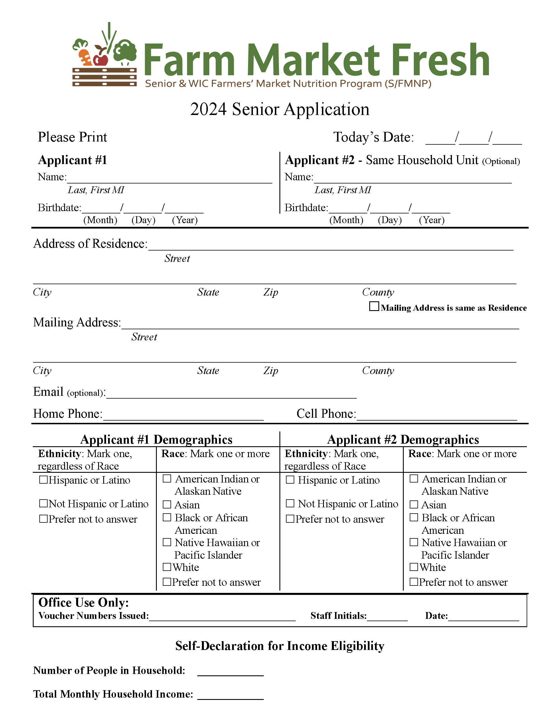
2024 Senior Application Page #1

Slide 3
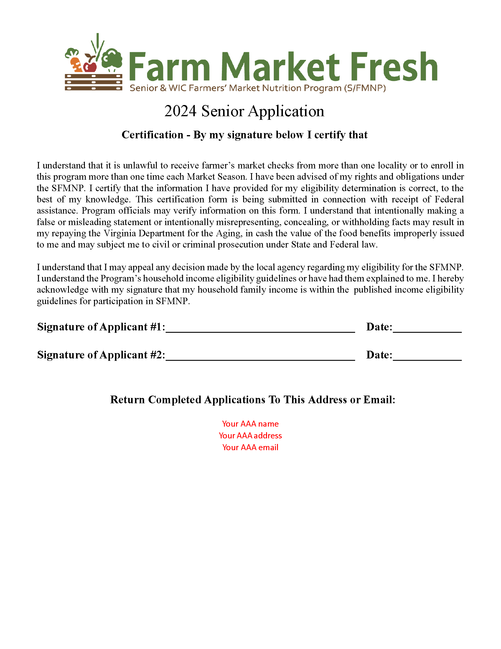
2024 Senior Application Page #2
*Page 3 is Nondiscrimination Statement*

Slide 4
2024 Online Process
Senior finds application on FarmMarketFresh.org or on your AAA website and clicks to open it.
Senior completes application and your designated application reviewer receives an email with the applicant details.
Designated application reviewer accepts or denies senior’s application based on eligibility criteria. (income eligibility guidelines will be provided)
Your AAA contacts applicant to inform of acceptance or denial and coordinates voucher booklet and program materials pickup/mailing.

Slide 5
Online Application Walk-through to come
Please let me know who will be reviewing online applications by filling out the form below. If you do not fill this out, I will just make it all emails I have for your agency in our Farm Market Fresh contacts sheet.
Online Form: https://forms.office.com/g/SUukN1r9HJ

Slide 6
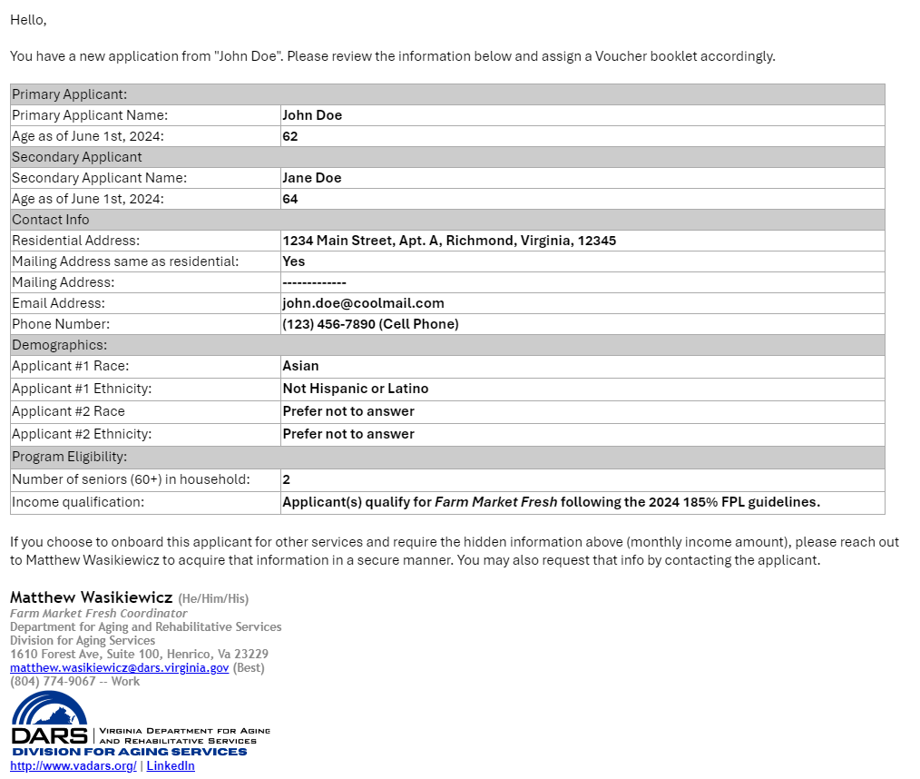
Example Email
Subject line:
Always will be: “New Farm Market Fresh Application”
Sensitive information will be hidden.
I have starred info that will be hidden.
DOB: Applicants will input their DOB, but you all will only see their age.
Income: Applicants report income, but you all only know if they qualify.

Slide 7
Creating an Inbox Rule/Filter - Why
You can create an email rule to automatically sort emails based on a set element of the email.
This will make sure your inbox does not overflow with application emails.
Easily view all applications that need review without other emails mixed in.

Slide 8
Creating an Inbox Rule/Filter - How
Rule Title: 2024 Senior Application
Rule Condition: Subject line Includes
All Applications will be subjected “New Farm Market Fresh Application”
Rule Action: Move or assign to Folder/Label
Recommended – title folder “Needs Action – 2024 Senior Applications”
Rules for Outlook
Filters for Gmail
If you use another email service, please reach out to Matthew for assistance with setting up a rule/filter.

Slide 9
What’s Next?
You will be receiving the following materials next week.
Link for Online Application
QR Code for Online Application
Customizable Word Doc. Application
PDF Proxy Form
Income Eligibility Guidelines Document

Slide 10
When can you open the application?
You may make the application available no earlier than April 1st.
If you choose to make you application available later than April 1st, please inform me of your chosen date.
Remember, voucher booklets will not be delivered to your agencies until May.

Slide 11
Questions?
If you have any questions after this training, please reach out to me.
Matthew Wasikiewicz
Farm Market Fresh Coordinator
* matthew.wasikiewicz@dars.virginia.gov
( 804.774.9067

